Slide 1


The Danish Telescope transit project
MiNDSTEp introductory session 2026/04/17
John Southworth
(Keele University, UK)
Image credit: https://xkcd.com/2977/

Slide 2
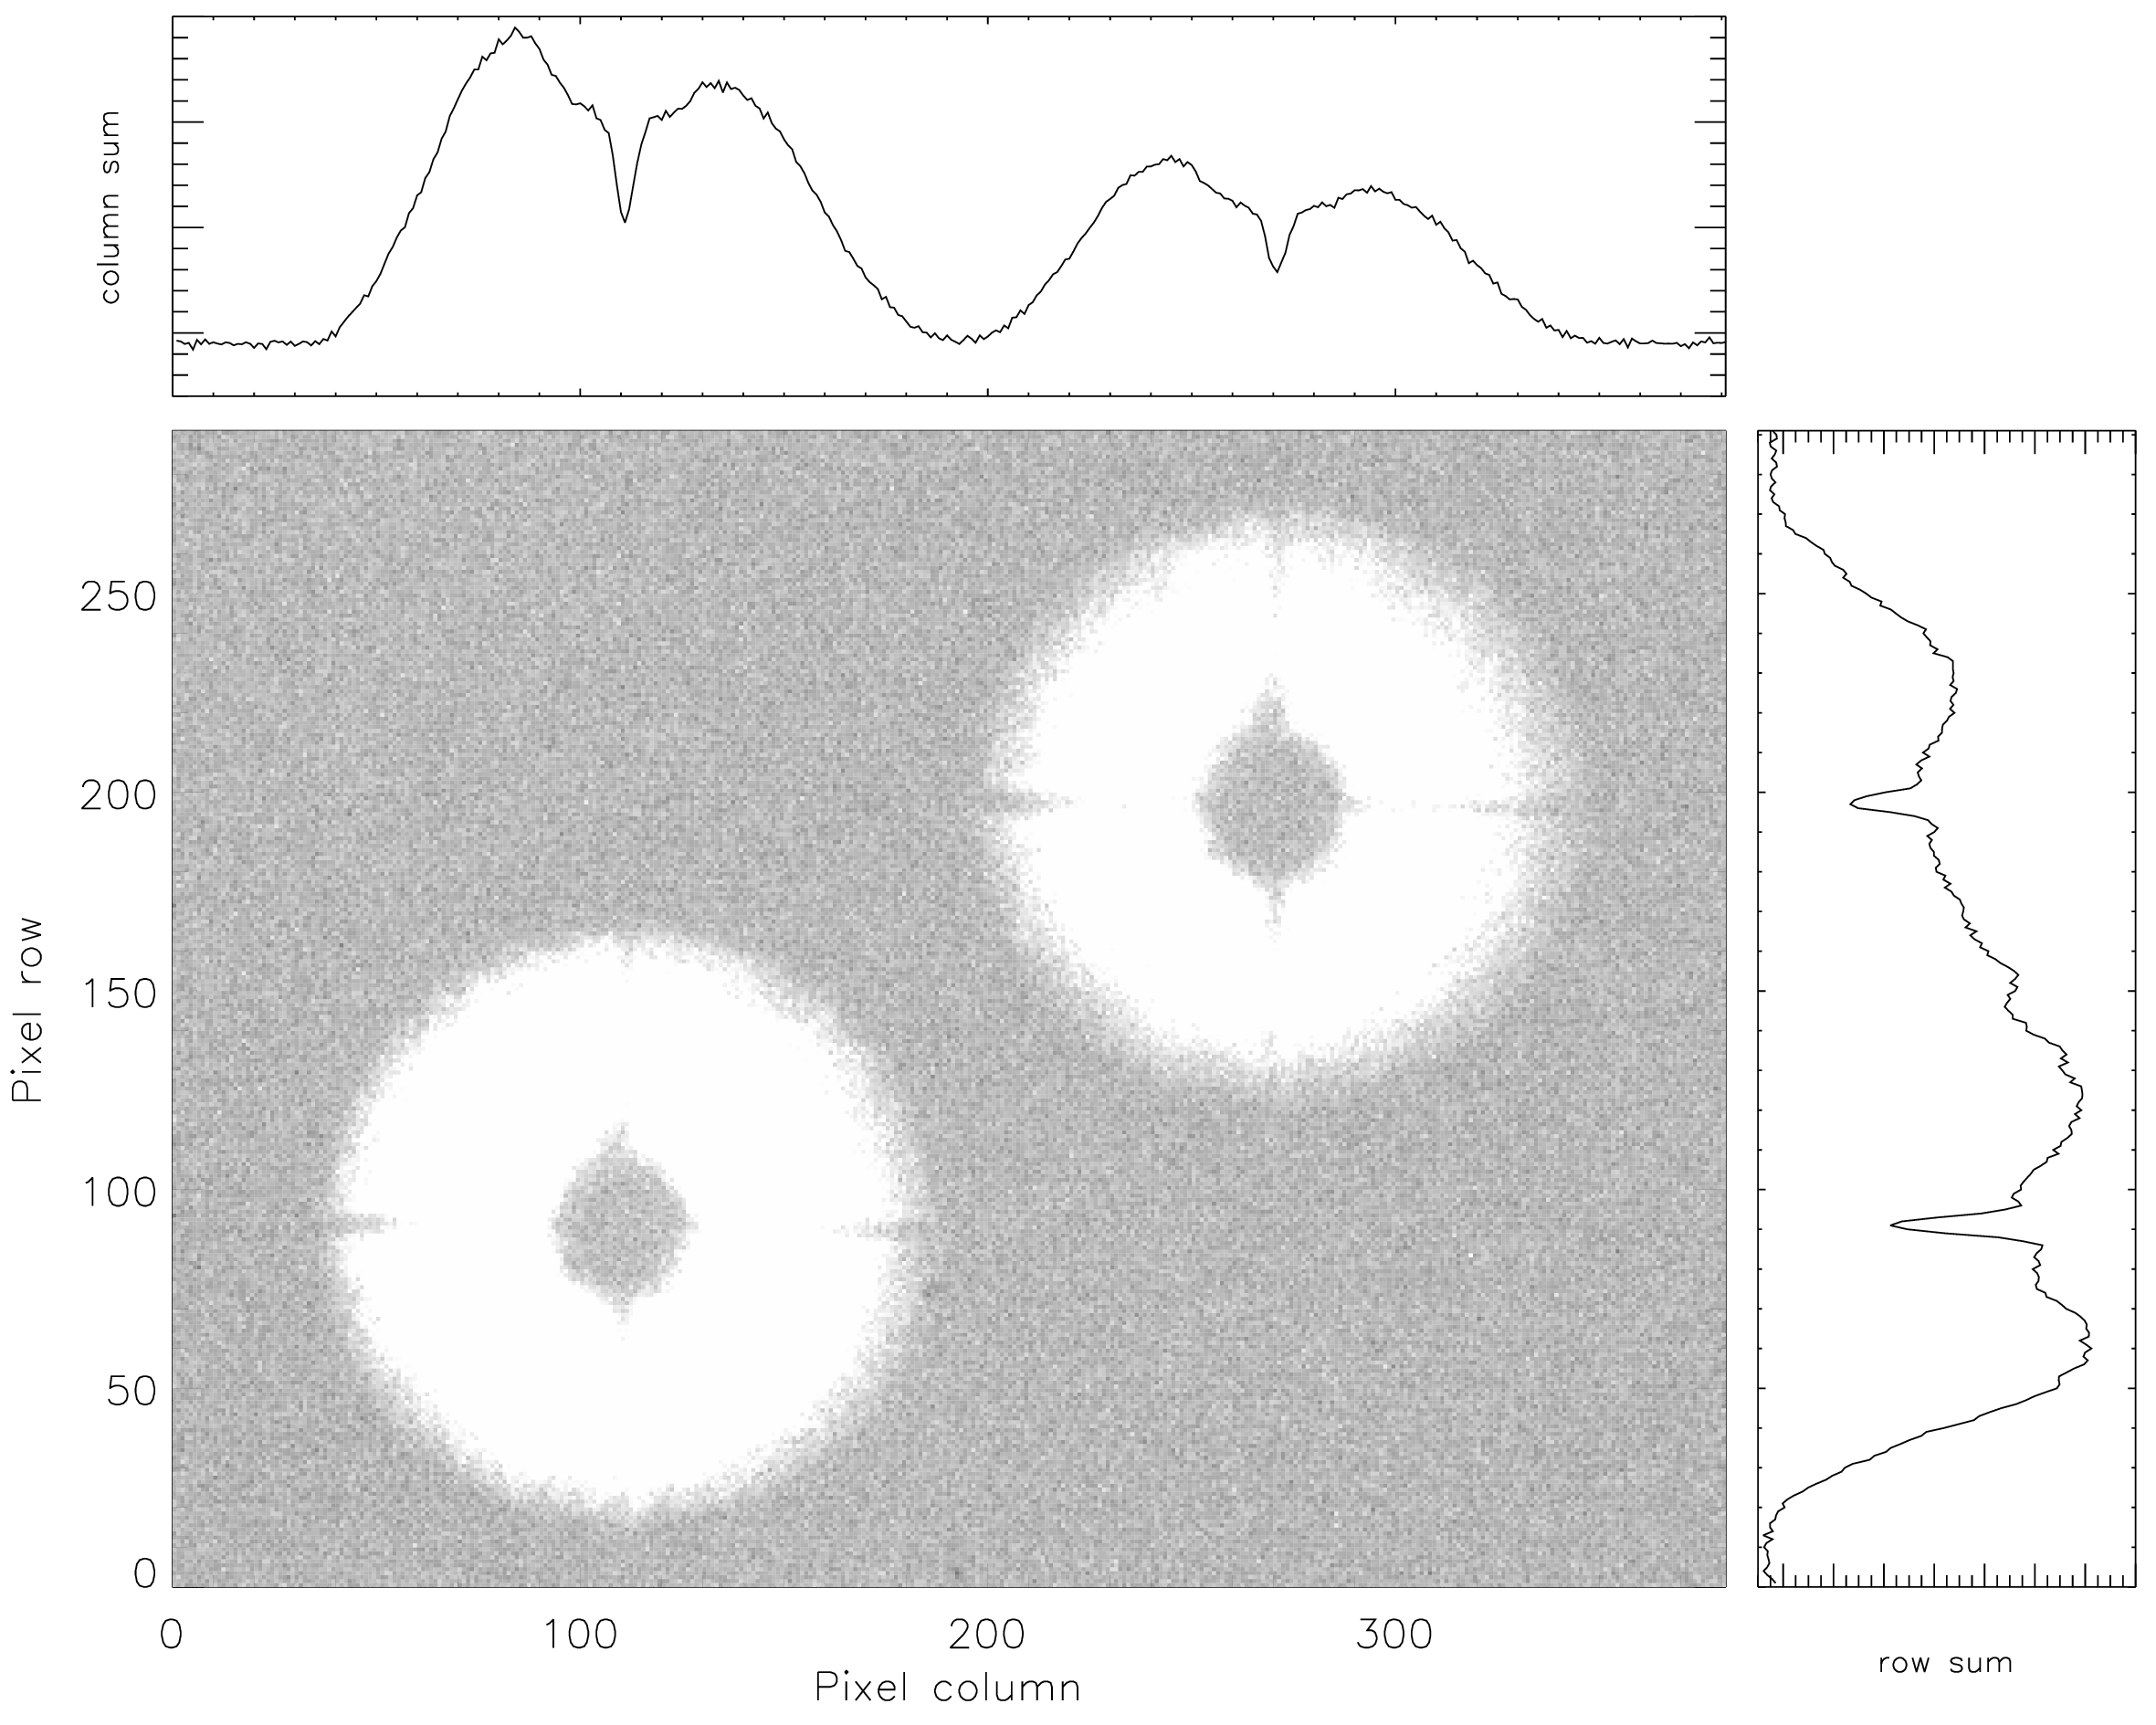
The Danish Telescope transit project
Historical perspective
Scientific goal
A bit of maths
Why defocussing?
How do we do it?
Example
Current status
Defocussed stars observed with the INT/WFC

Slide 3
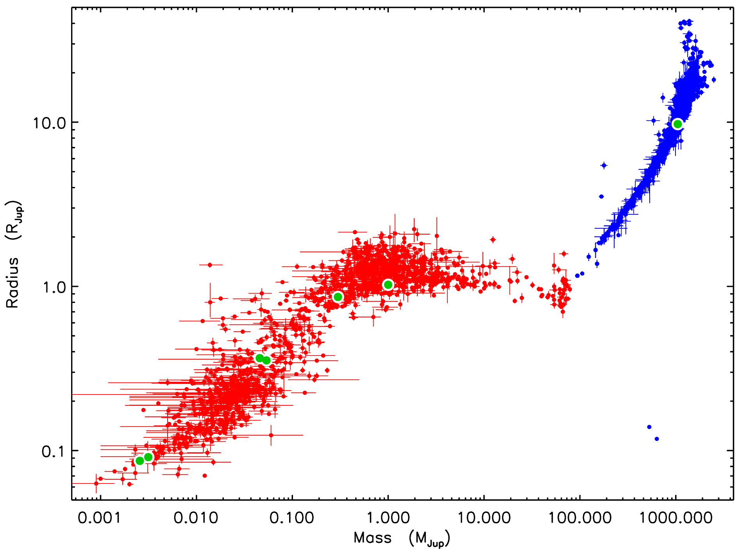
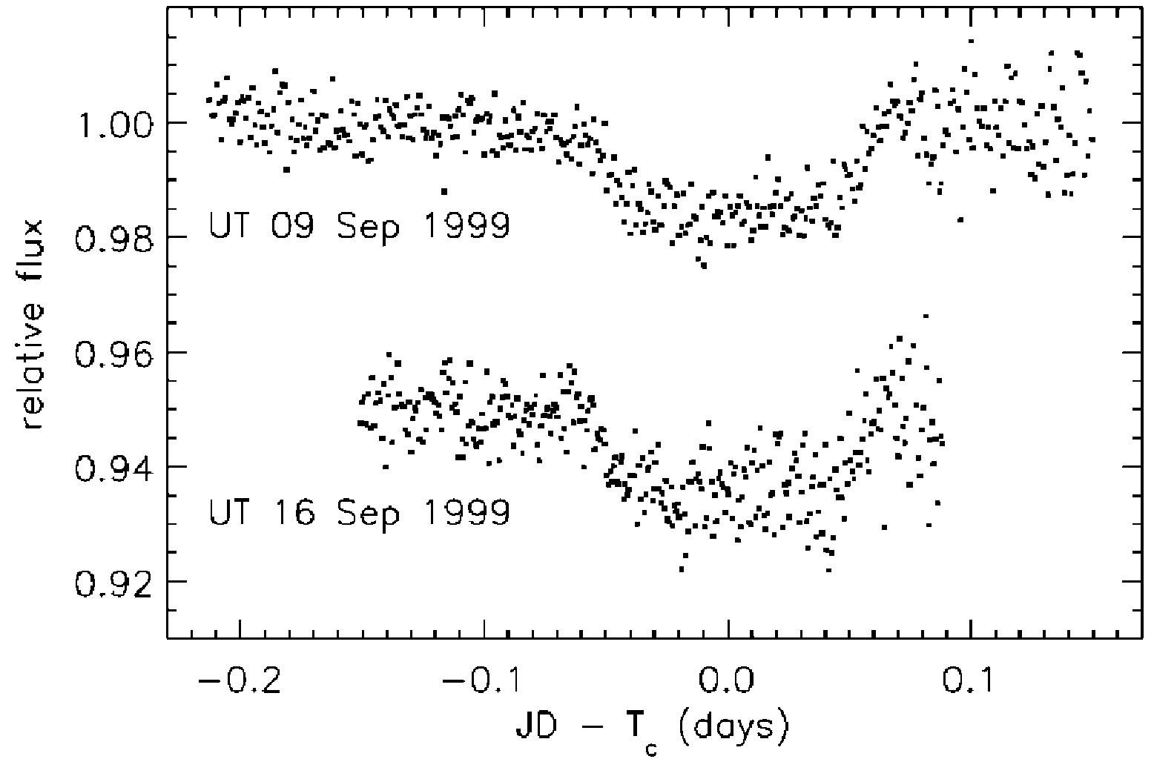
Scientific goal
Over 4000 transiting planets now known
But back in 2007 only 14 known
Difficult to measure their properties because transit light curves were bad
We needed better light curves
Discovery light curve of HD 209458 (Charbonneau et al., 2000, ApJ, 529, L45).
Mass-radius plot of transiting planets and their host stars. Image credit: figure 4 from Southworth (2026, Universe, 12, 62).

Slide 4
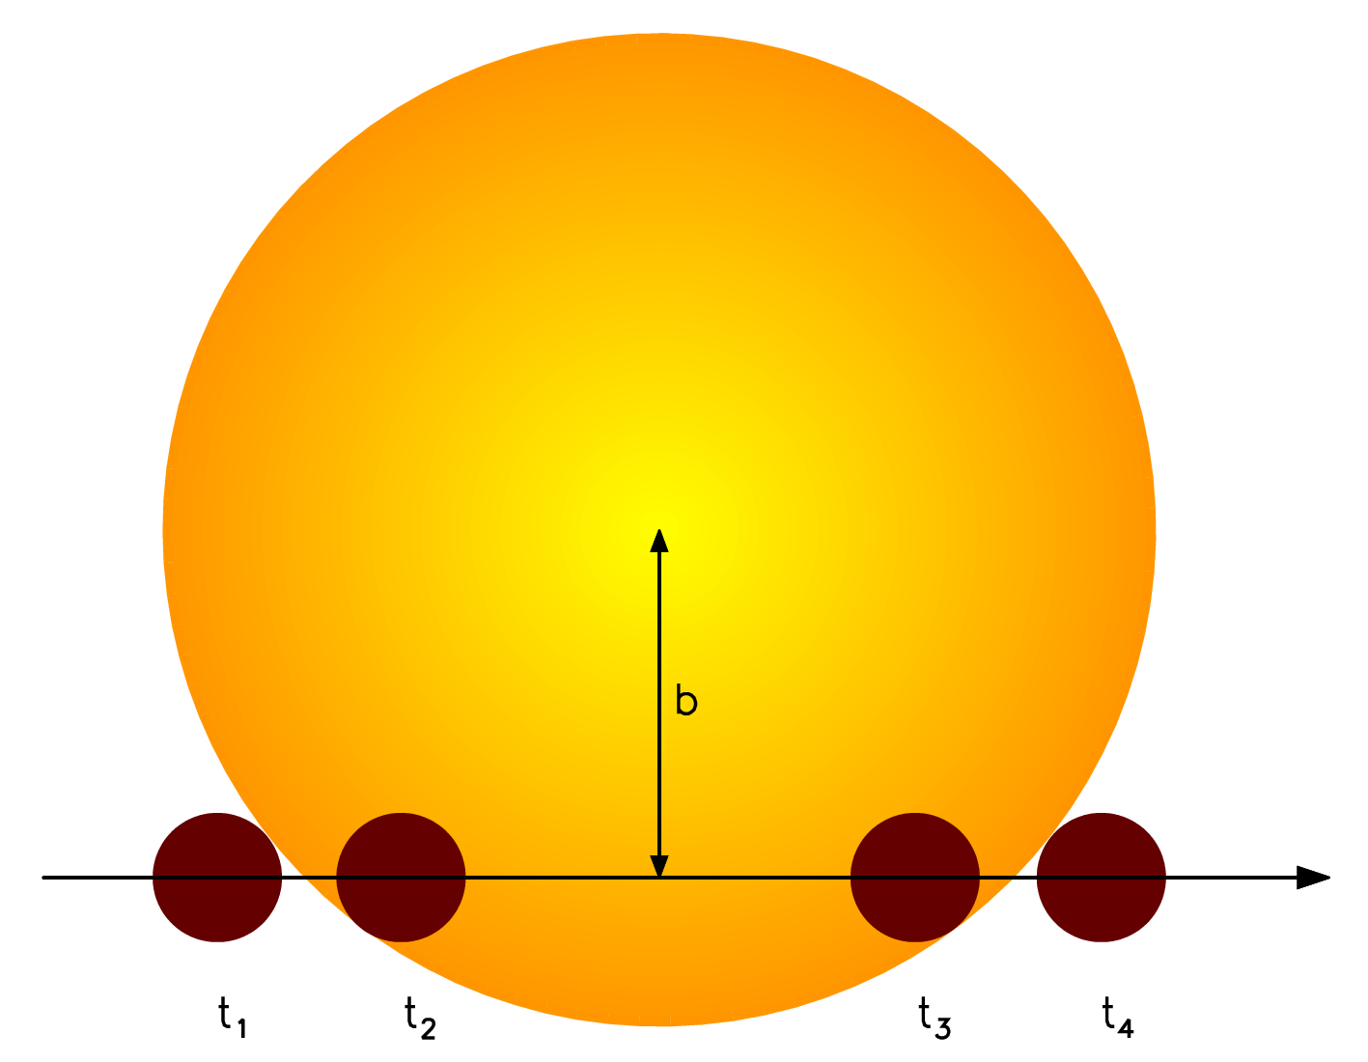
A bit of maths
The duration of a transit gives the sum of the fractional radii of the components:
The depth of the transit gives the ratio of the fractional radii:
If we know the semimajor axis we get the true radii:
Full process covered in many textbooks
$t_{\left(4−1\right)}=\frac{P}{π}\sqrt{{\left(r_{s}+r_{p}\right)}^{2}−\cos^{2}i}$
$ΔF={\left(\frac{r_{p}}{r_{s}}\right)}^{2}$
$R_{s}=ar_{s}$
$R_{p}=ar_{p}$
Diagram of a planetary transit. The times of contact are labelled as t1 to t4. The impact parameter is b.

Slide 5
How and why do we defocus?
How do we do it?
Defocus the telescope by moving the secondary mirror
For the Danish telescope a typical value is ~0.3 mm
Why do we do it?
Spread light over many pixels: pixel response averages out
Spend less time reading out the CCD: more time collecting photons
Defocussed stars observed with the INT/WFC

Slide 6
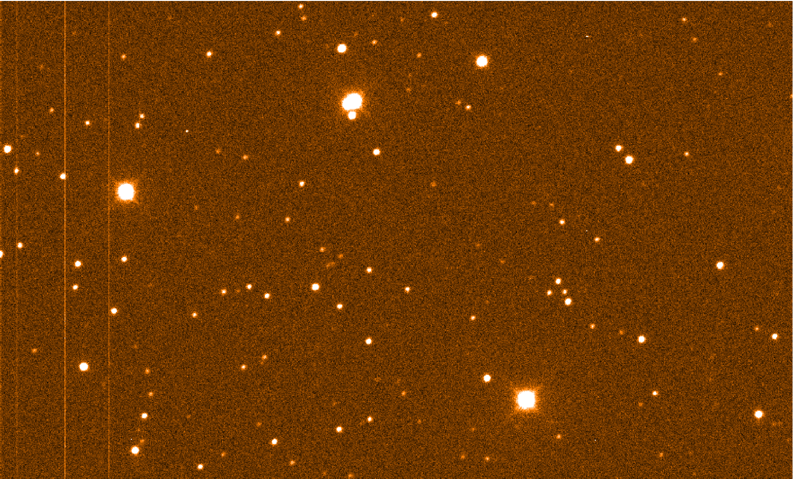
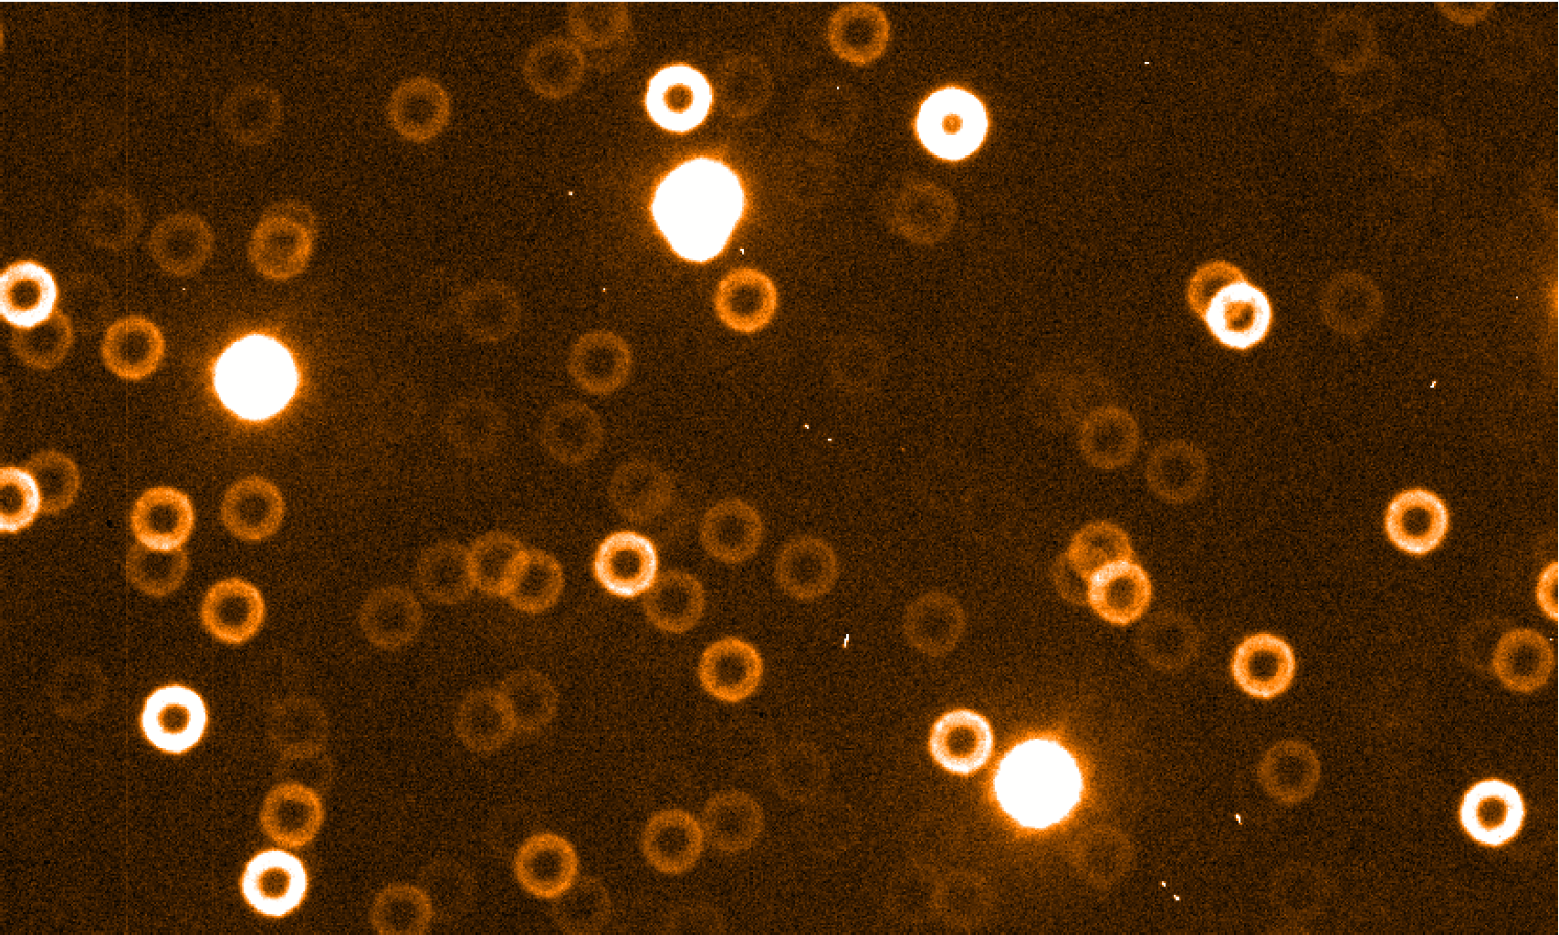
Example: WASP-2
Image of the sky around WASP-2 taken by the Danish Telescope on 2009/08/24 (in focus)
Image of the sky around WASP-2 taken by the Danish Telescope on 2009/08/24 (defocussed)

Slide 7
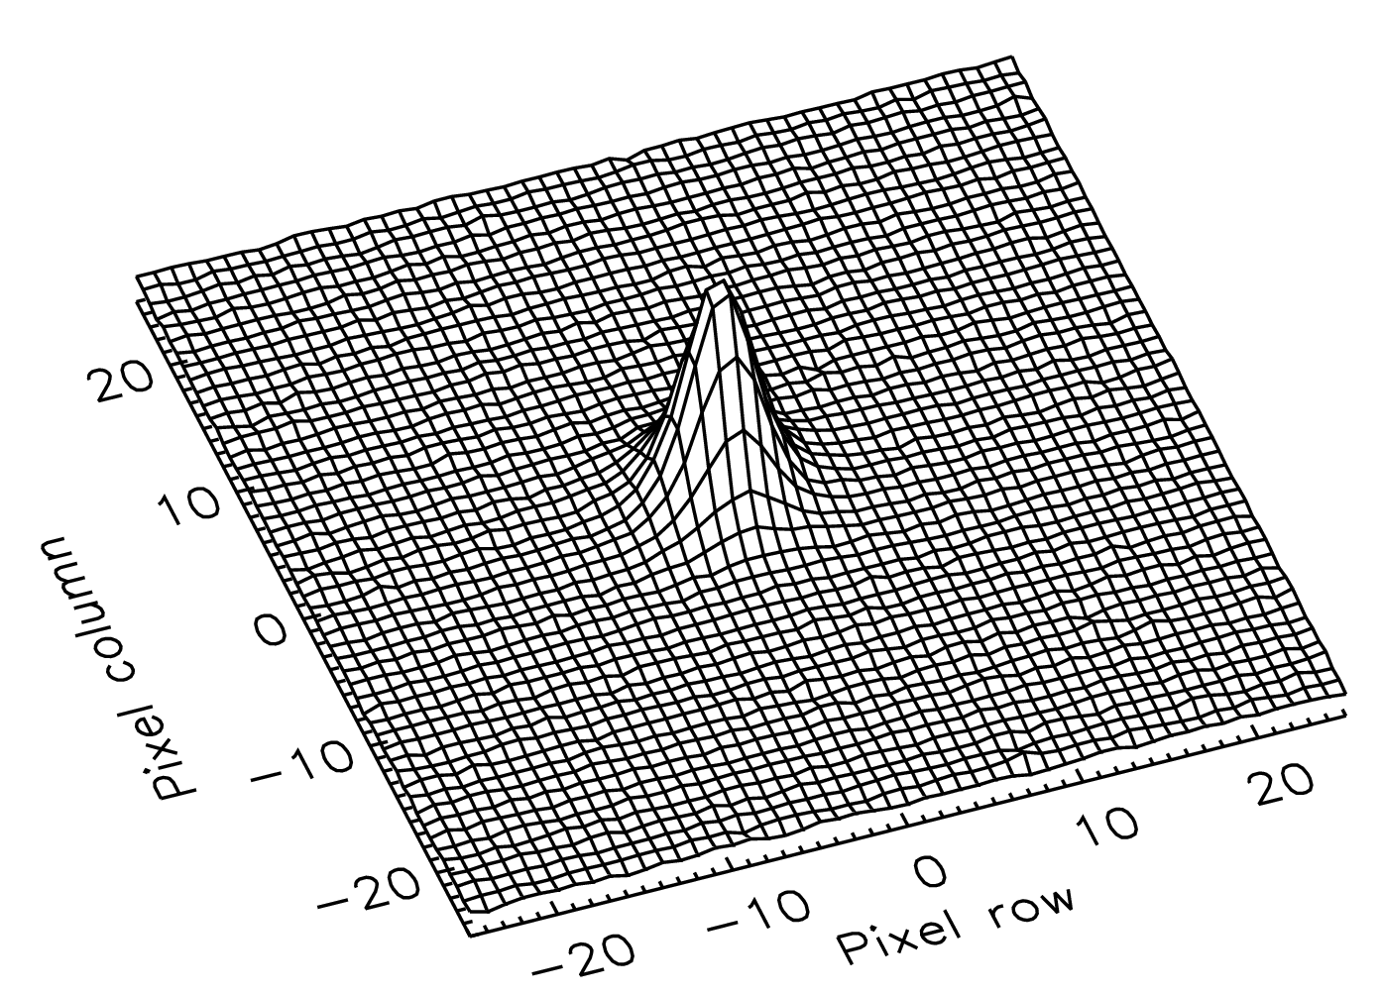
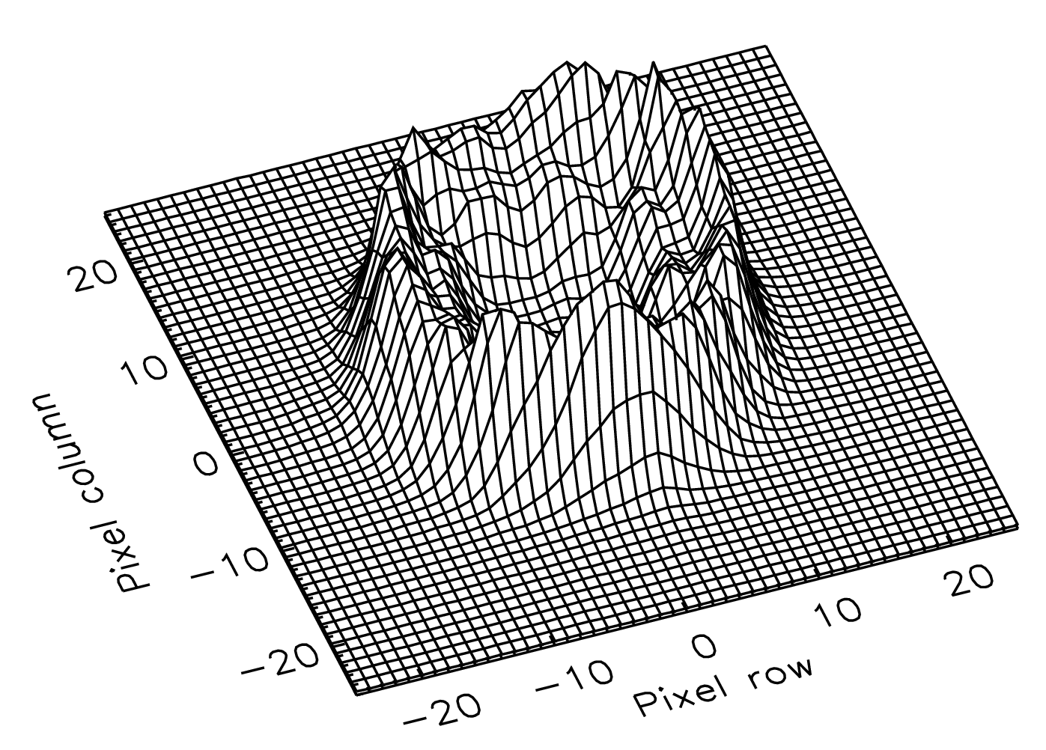
Example: WASP-2
PSF of WASP-2 taken by the
Danish Telescope on 2009/08/24 (in focus)
PSF of WASP-2 taken by the Danish Telescope on 2009/08/24 (defocussed)

Slide 8
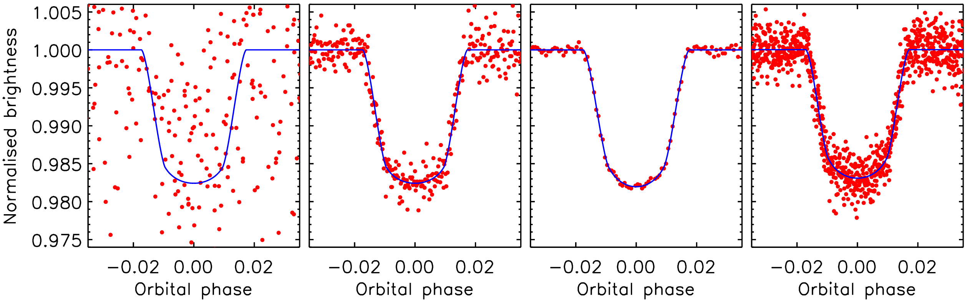
Example: WASP-2
Panel (1): the discovery light curve of WASP-2 from the SuperWASP telescopes. Panel (2): light curve from a 1.3m telescope observed in focus (Charbonneau et al., 2007). Panel (3): light curve from the Danish telescope with defocussing (Southworth et al., 2010). Panel (4): light curve from one sector of TESS observations.

Slide 9
Transit project: current status
The transit project has been running since 2008
So far 28 papers published and two in preparation
We have observed over 60 targets
Mostly transiting planets
A few eclipsing binaries and other interesting objects too
Space missions (Kepler, TESS, PLATO) have changed all planetary research. We can only compete for some types of object
Main science now is long-term monitoring to find orbital decay

